Slide 1
QuickSip Analysis and Business Plan
By: Ashley Marietta
Notes:
Good afternoon. Today, I will share an analysis of menu items for my favorite coffee shop in my hometown, as well as a few business insights I drew from my data.

Slide 2
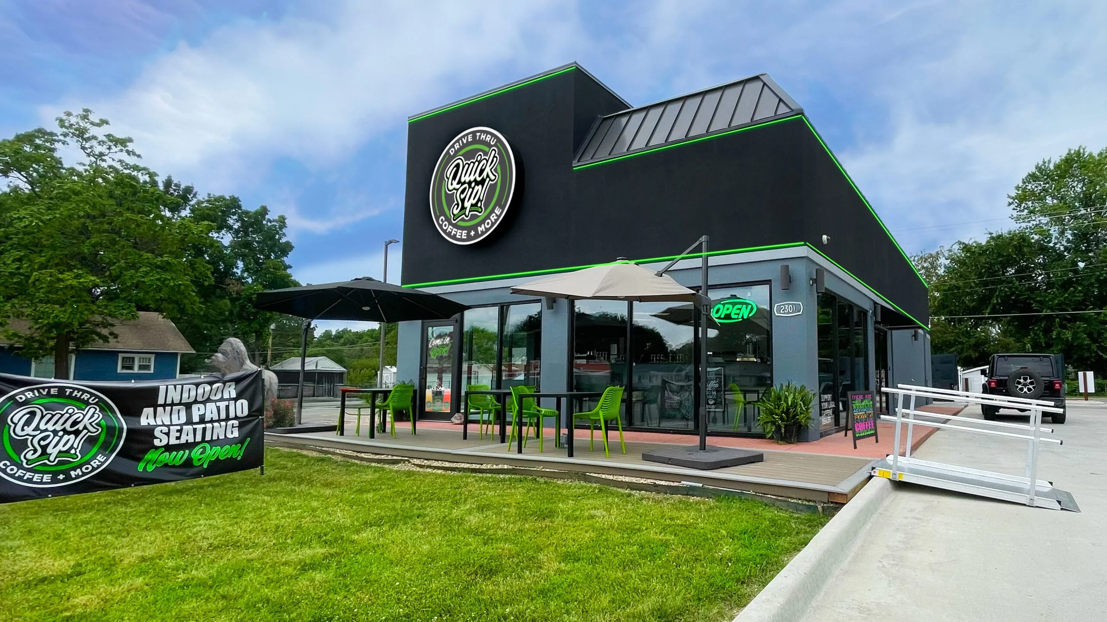
Background
QuickSip is a local, family-owned coffee shop in Pittsburg, Kansas, based on a sales model of fast service times and vast menu options.
However, in a small college town with several other nearby coffee shops like Starbucks, 7 Brew, and Scooters, they face the issue of intense competition with a small customer population to draw from.
Notes:
Pittsburg, Kansas, is a small town of around 20,000 residents with a medium-sized college called Pittsburg State University on the south side of town. Especially for a town of this small size, it has multiple chain coffee shops, including Starbucks, Scooters, and 7 Brew, and two local coffee shops, all on the north side of town.
I often see many cars in the parking lots for the other chain coffee shops, but QuickSip, a local, family-owned coffee shop, that markets its fast service and large menu as selling points, is rarely as busy.

Slide 3

01
Goal
Notes:
Thus, my goal in this project is to analyze what QuickSip’s menu focus is so that I can understand their sales emphasis and how that may be impacted by other businesses nearby.
To do so, I scraped their website and consolidated the data into a Pandas dataframe.
From there, I counted the number of menu items in each major category.
Finally, I compared the average pricing of each category of menu items, including seasonal drinks like holiday, fall, and summer beverages, to see which those could be a potential area of business focus.

Slide 4
02
Analysis
Notes:
- I evaluated the data findings on two levels: the number of items in each category and the average price of each category.

Slide 5
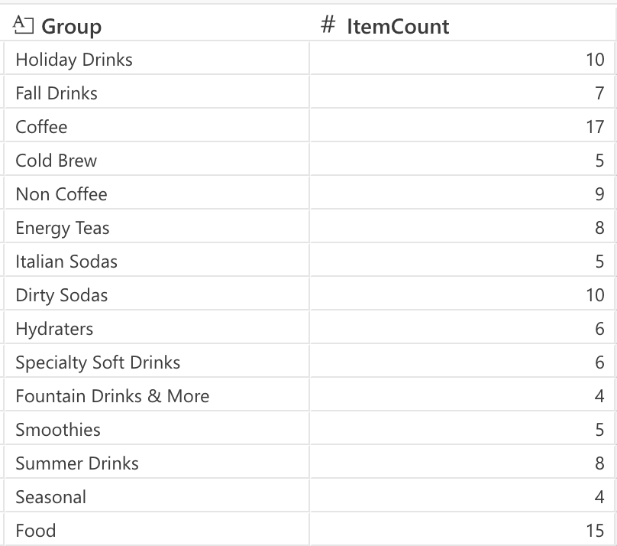
Item Quantities by Category
Emphasis on coffee drinks and food items
- Holiday/seasonal drinks
Notes:
Based solely on the count of menu items, it appears that QuickSip focuses primarily on coffee drinks, which also include a large portion of the holiday, fall, and summer drinks.
However, what could set QuickSip apart from other similar businesses is their secondary focus on food, such as chicken strips, pizzas, and breakfast sandwiches. Their food menu has evolved greatly in the last year, beginning with only snack items like mozzarella sticks and now morphing into meals.

Slide 6
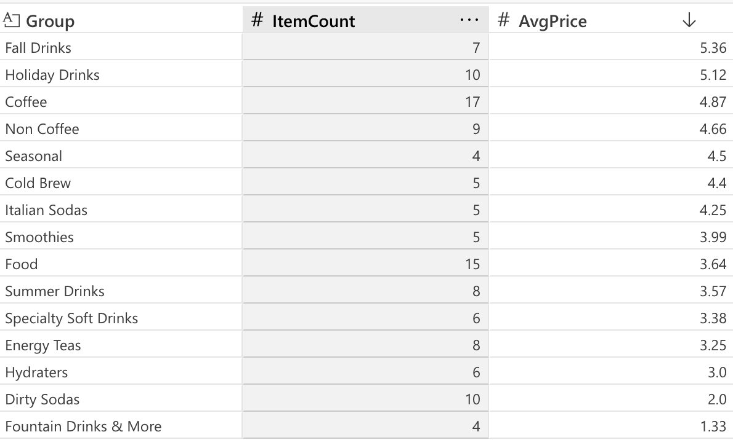
Average Prices by Category
Markup on seasonal drinks
Primary expense on coffee drinks

Slide 7
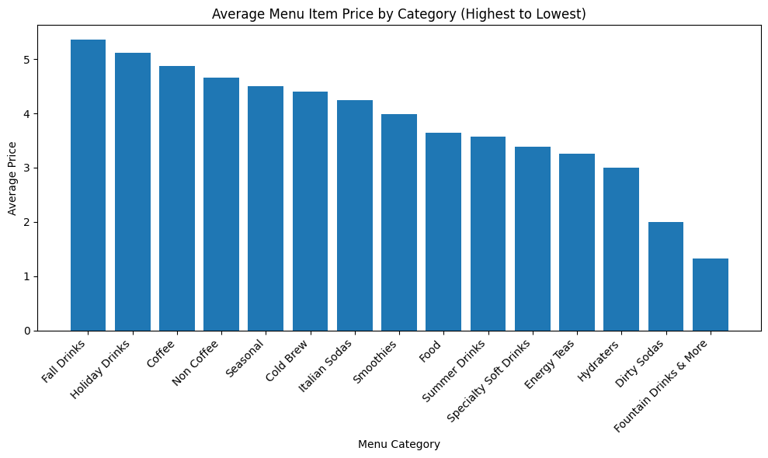
Notes:
In looking at the average prices for each menu category, it is clear that specialty drinks do have a higher price. Taking into account that the price is for the smallest size beverage without any modifications (such as alternative milks or extra syrups), there could also be some price variability that is not accounted for in specialty beverages that may not be as prevalent for fountain drinks or food.
Overall, the menu shows a clear emphasis on higher-priced specialty beverages, suggesting that QuickSip focuses on premium, customizable drink offerings rather than low-cost commodity beverages.

Slide 8
Significance
Notes:
- Now the real business question: why does this information matter, and what does it mean for QuickSip moving forward?

Slide 9
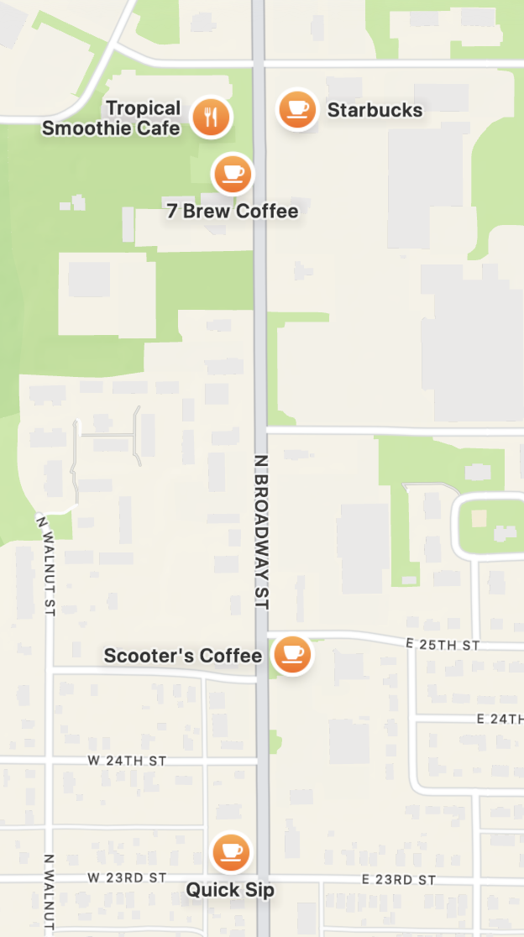
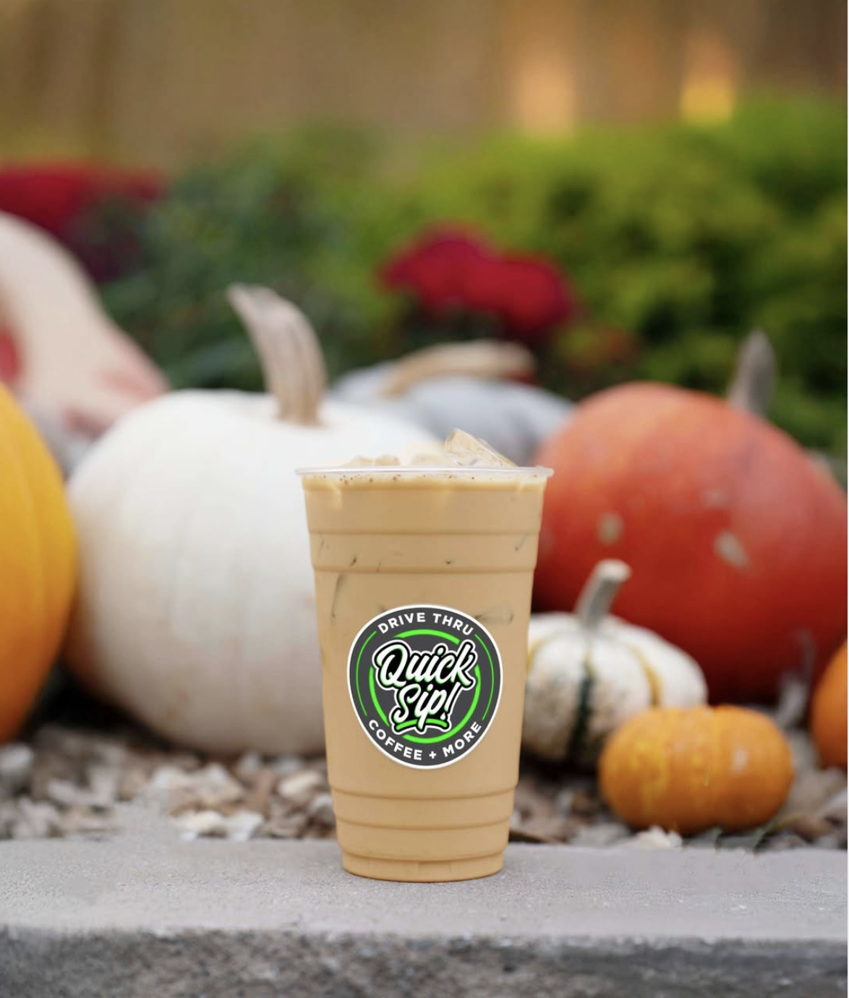
Concluding Thoughts
Sales model shift
Location change
Notes:
Given their competition, I have two suggestions for QuickSip based on my menu scraping.
First, I propose that altering their menu to focus more on food items or smoothies could make more financial sense. Because their coffee drinks are their most expensive products, I wonder if consumers are unwilling to pay higher prices when there are plenty of alternatives just down the road.
Thus, I also would consider moving further south near Pittsburg State University to pull customers from the college population. No crowd loves an overpriced coffee or boozy slush like college students!
In conclusion, while my analysis could be expanded by having consumer sales data or customer feedback, I expanded my coding skills and confidence in throughout this project, which I could not be more grateful for. It was eye-opening to see how much work goes on under the hood to extract data from the web, even for a humble coffee shop in a small town in rural Kansas.

Slide 10
Thanks!
Notes:
- This concludes my presentation, and I am happy to answer any questions you may have. Thank you!

